Slide 1
Session 3: DC Motor,Transistor, Flyback Diode, and Other Parts

Slide 2
What We Learn Today
How to use a DC Motor
DC Motor
Transistor
Flyback Diode
Other Electric Parts
Solenoid
Relay
MP3 Player
MINI LCD Display

Slide 3
Session 3.1: How to Use a DC Motor

Slide 4
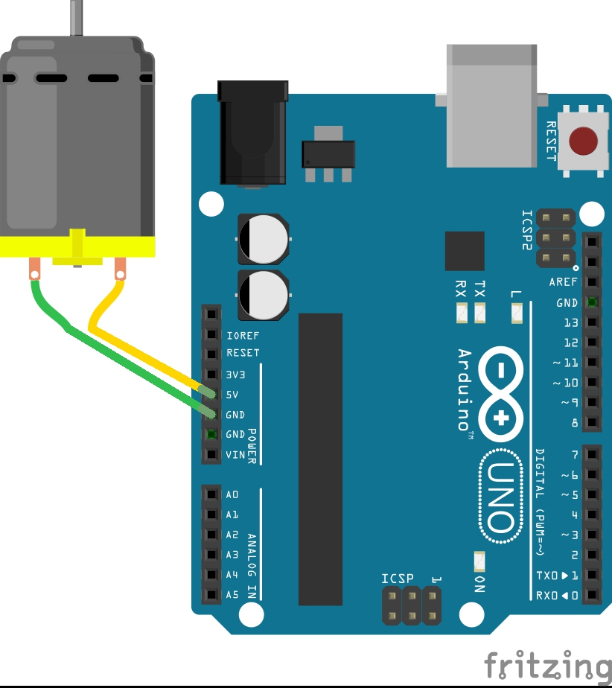
DC Motor
Just connecting a DC motor to the Arduino’s digital output doesn’t work.

Slide 5
DC Motor
Why?
Arduino can’t supply enough electric current to drive a DC motor (the Arduino’s digital output can supply max 20mA).

Slide 6
DC Motor
Why?
Arduino can’t supply enough electric current to drive a DC motor (the Arduino;s digital output can supply max 20mA).
We need an external power supply and
control it by the Arduino’s digital/analog output.

Slide 7
Transistor
Transistors can be used to amplify the electric current.
A transistor has 3 legs.
Emitter
Collector
Base
If the current flows from the base to the emitter, the transistor amplifies the current from collector to emitter.
Image: https://en.wikipedia.org/wiki/Transistor#/media/File:Transistor_Simple_Circuit_Diagram_with_NPN_Labels.svg (license: CC-BY-SA 3.0).

Slide 8
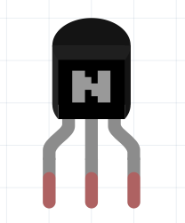
Transistor
The pin order of PN2222A transistor is assigned as shown on the right.
The pin order differs among transistors.
Be sure to check the pin order of your transistor.
E
B
C

Slide 9
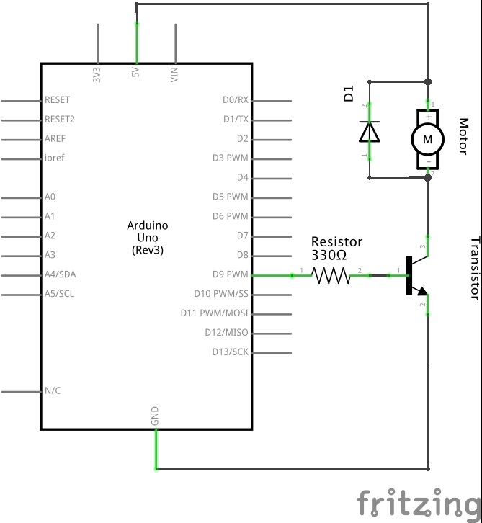
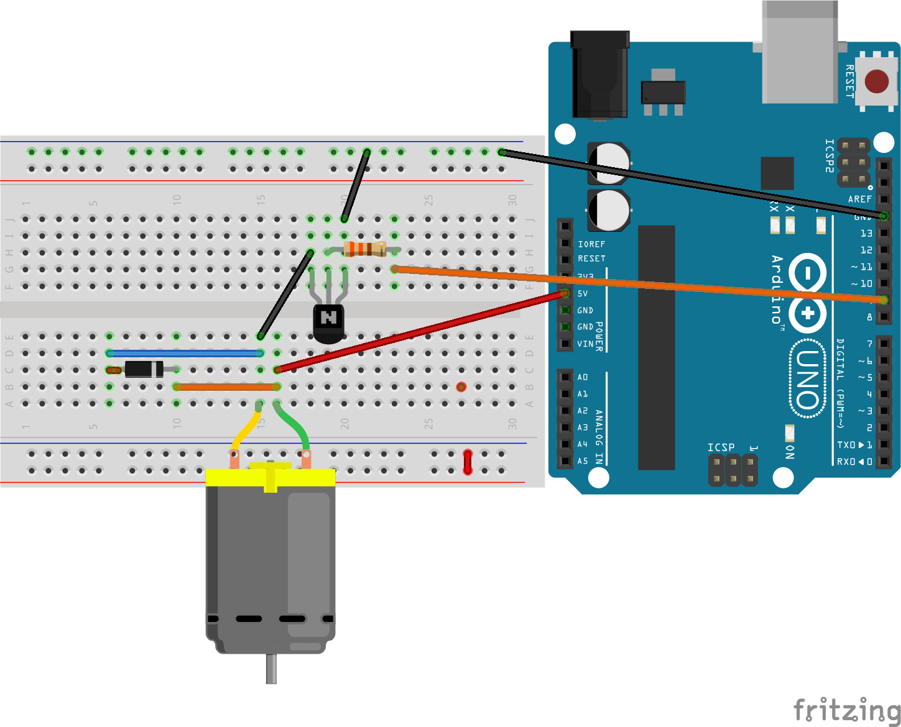
Transistor
Let’s build a circuit with a transistor!

Slide 10
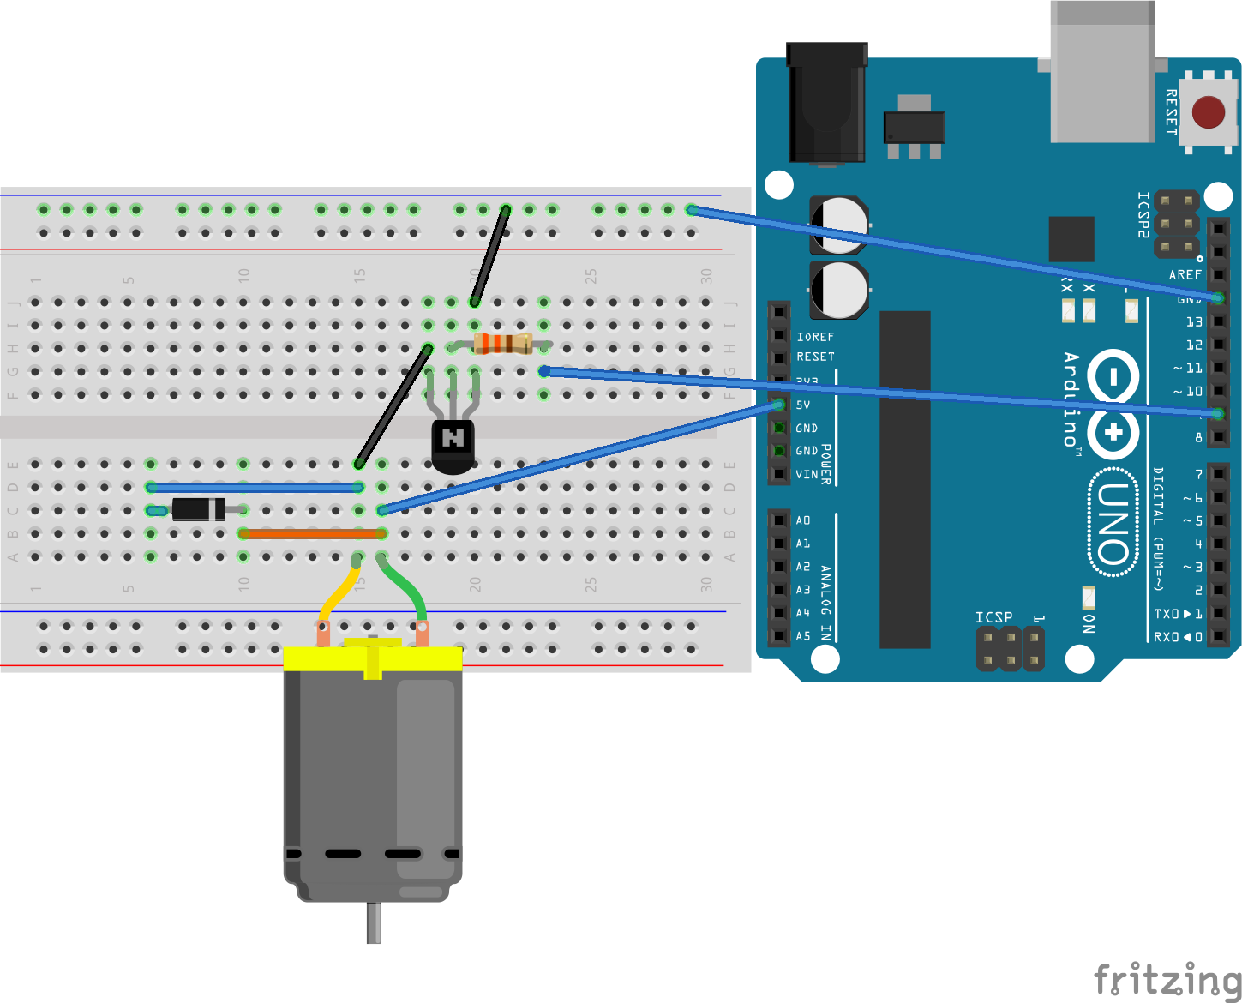
Transistor
The digital output #9 is connected to the ‘base’ pin of the PN2222A transistor (via a 330Ω resister）, then it is connected to the ground via the emitter.
E
B
C

Slide 11
Transistor
The power is supplied from the 5v pin and drawn to the collector (then, going to the GND via the emitter). The amount of the electric current of this route is controlled by the output from the digital output that goes through the base.
E
B
C

Slide 12
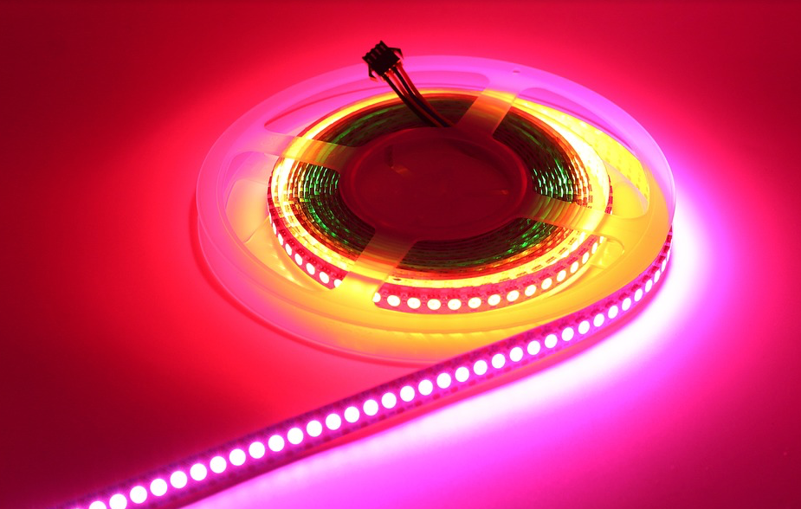
Transistor
You can use a transistor for various purposes.
For example, a LED strip normally requires more electric current, and may also require higher voltage.
Using a transistor, you can control the on/off by the digital output and brightness by PWM.
image: https://pixabay.com/p-2103022/?no_redirect (Pixabay License, Free for commercial use. No attribution required)

Slide 13
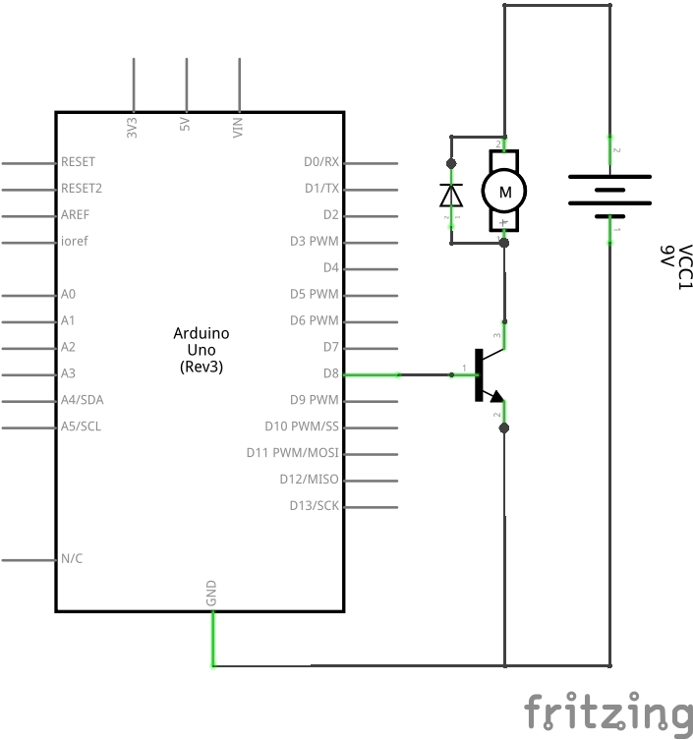
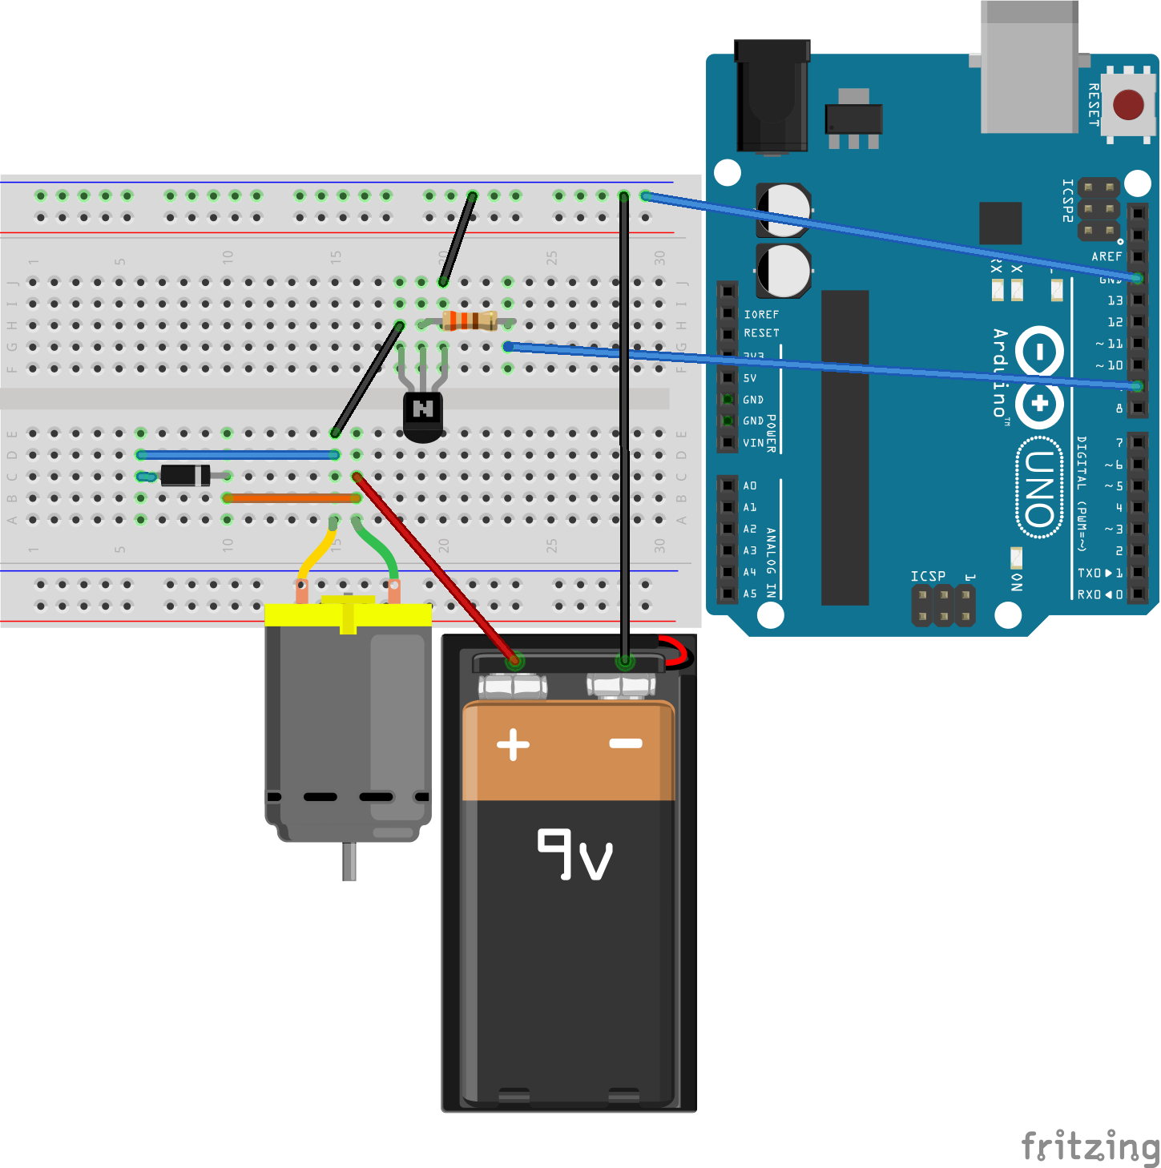
DC Motor
You can also use an external power source (just share the GND).

Slide 14
DC Motor
Now we learned how to control a a DC Motor, but what is this?

Slide 15
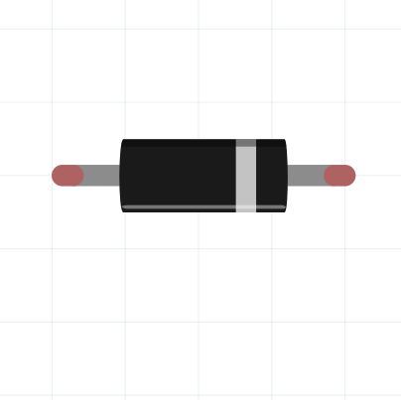
Flyback Diode
This is a diode.
We already used one. LED = Light Emitting Diode.
Electric current can flow only from the anode side to the cathode side.
Anode
Cathode

Slide 16
Flyback Diode
Then, why do we need a diode here?

Slide 17
Flyback Diode
A motor has magnetic coils inside.
When the circuit is closed, the electric current flows through the magnetic coil.

Slide 18
Flyback Diode
What happens when the switch is set off?
Magnetic coils have the characteristic to resist the change of the current.
If the current increases, a magnetic coil opposes by
self-induced EMF: Vr = -L * ΔI/Δt
This means ”if the electric current drops down a lot suddenly, self-induced EMF will be very large”.
This can cause a very large voltage (even more than 5 to 20 times than the original voltage) , and it can break your circuit (including your Arduino!!).
A flyback diode can be used to avoid such a situation.

Slide 19
Flyback Diode
an electric arc
Note that the polarity changes but the electric current flows to the same direction.
The images are from https://upload.wikimedia.org/wikipedia/commons/7/76/FlybackExample.GIF and https://upload.wikimedia.org/wikipedia/commons/f/f8/Lichtbogen_3000_Volt.jpg . (license: CC-BY-SA 3.0 for both images)

Slide 20
Flyback Diode
This is why we need a flyback diode.

Slide 21
Flyback Diode
While the DC motor is active, it stores the energy.
The electric current doesn’t go through the blue route, as the electric current can’t flow from cathode to anode.
+
-
-
+

Slide 22
Flyback Diode
While the DC motor is stopped, it releases the stored energy and tries to keep the same flow of the electric current as possible.
However, the electric current won’t go through the transistor, as the base current is not given.
-
+
However, it can go through the flyback diode, as now it is the motor that supply the electric current.
Thus, the sudden large voltage can be avoided and the circuit (including your Arduino!) can be protected.
This electric current will be stopped when the motor already consumed all the stored energy.
+
-
22

Slide 23
Flyback Diode
While the DC motor is stopped, it releases the stored energy and tries to keep the same flow of the electric current as possible.
However, the electric current won’t go through the transistor, as the base current is not given.
However, it can go through the flyback diode, as now it is the motor that supply the electric current.
Thus, the sudden large voltage can be avoided and the circuit (including your Arduino!) can be protected.
This electric current will be stopped when the motor already consumed all the stored energy.
+
-

Slide 24
Transistor
I_{C} - V_{CE}
1000
COLLECTOR CURRENT I_{C} (mA)
COMMON EMITTER
Ta = 25℃
How much electric current should be provided for the base-emitter?
Let’s say we use the 3V for the motor and we want to provide 500mA for the motor.
Let’s see the datasheet!
There would be something similar to the right figure.
800
8
7
6
600
5
4
400
3
2
200
I_{B} = 1mA
0
0
1
2
3
4
5
6
COLLECTOR-EMITTER VOLTAGE V_{CE} (V)
Image: created by the author, following TOSHIBA. 2SC2120 Datasheet.

Slide 25
Transistor
I_{C} - V_{CE}
1000
We use the 3V for the motor and we want to provide 500mA for the motor.
First, check the ‘3V’ at the X-axis.
COLLECTOR CURRENT I_{C} (mA)
COMMON EMITTER
Ta = 25℃
800
8
7
6
600
5
4
400
3
2
200
I_{B} = 1mA
0
0
1
2
3
4
5
6
COLLECTOR-EMITTER VOLTAGE V_{CE} (V)
Image: created by the author, following TOSHIBA. 2SC2120 Datasheet.

Slide 26
Transistor
I_{C} - V_{CE}
1000
We use the 3V for the motor and we want to provide 500mA for the motor.
Then, check the 500mA on the Y axis.
COLLECTOR CURRENT I_{C} (mA)
COMMON EMITTER
Ta = 25℃
800
8
7
6
600
5
4
400
3
2
200
I_{B} = 1mA
0
0
1
2
3
4
5
6
COLLECTOR-EMITTER VOLTAGE V_{CE} (V)
Image: created by the author, following TOSHIBA. 2SC2120 Datasheet.

Slide 27
Transistor
I_{C} - V_{CE}
1000
The point (3v, 500mA) is at the middle of the 4mA line and the 5mA line.
Hence, we need to provide about the 4.5mA to the base.
The Arduino’s digital output is 5V.
We use V=IR again here! 5 = 0.0045 * R
R = 5 / 0.0045 = 1111.11…
We can use one 1k ohm resistor and one 200Ω resistor (1.2k in total).
COLLECTOR CURRENT I_{C} (mA)
COMMON EMITTER
Ta = 25℃
800
8
7
6
600
5
4
400
3
2
200
I_{B} = 1mA
0
0
1
2
3
4
5
6
COLLECTOR-EMITTER VOLTAGE V_{CE} (V)
Image: created by the author, following TOSHIBA. 2SC2120 Datasheet.

Slide 28
Ardestan Exercise #1
Create a program and a circuit that control the rotation speed of a DC motor by a potentiometer.

Slide 29
What We Learned So far
How to use a DC Motor
DC Motor
Transistor
Flyback Diode
Other Electric Parts
Solenoid
Relay
MP3 Player
MINI LCD Display

Slide 30
Session 3.2: Other Electric Parts

Slide 31
Solenoid
Solenoids are actuators that are electromagnetically drive.
There are various kinds of solenoids (push-pull, rotary, water valve, etc.)
The left figure is an example of a small push-pull solenoid.
Image: https://www.sparkfun.com/products/11015 (CC BY 2.0)

Slide 32
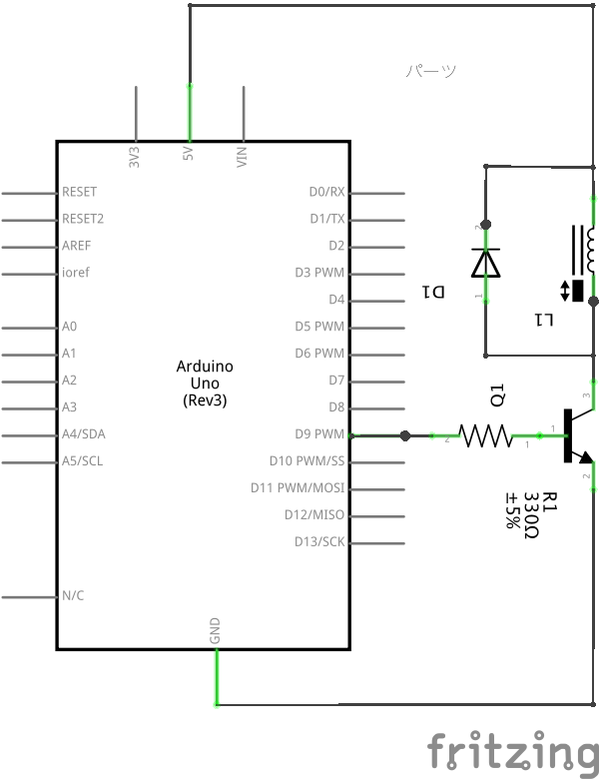
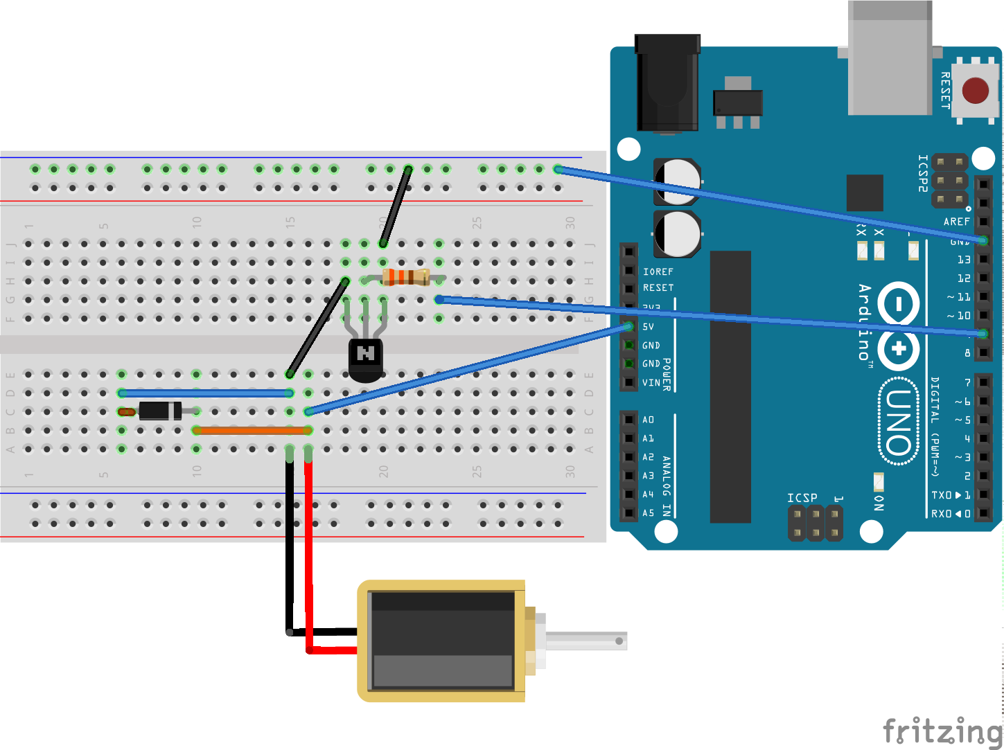
Solenoid
Solenoids can be used in the same manner as DC motors.

Slide 33
Solenoid
Explain Why we need a diode here.

Slide 34

Solenoid (Push-Pull)
video from: https://www.youtube.com/watch?v=W9j6ZRsOUrI

Slide 35

Solenoid Example (Water Valve)
video fromhttps://www.youtube.com/watch?v=tnPnwET4x9k&feature=emb_logo

Slide 36
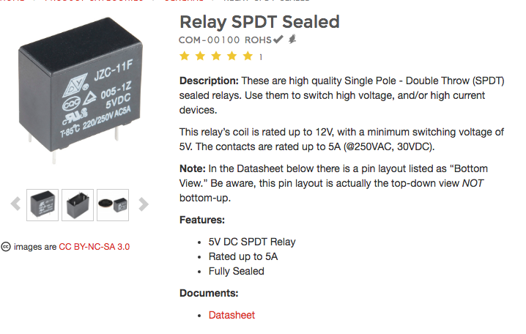
Relay
A relay is a switch that can be electrically operated.
Electromagnet is used for switching.
Check how much is min and max voltages to utilize.
Always check the data sheet!
Image: https://www.sparkfun.com/products/100 accessed on Oct- 21-2016. (License: CC BY-NC-SA 3.0)

Slide 37
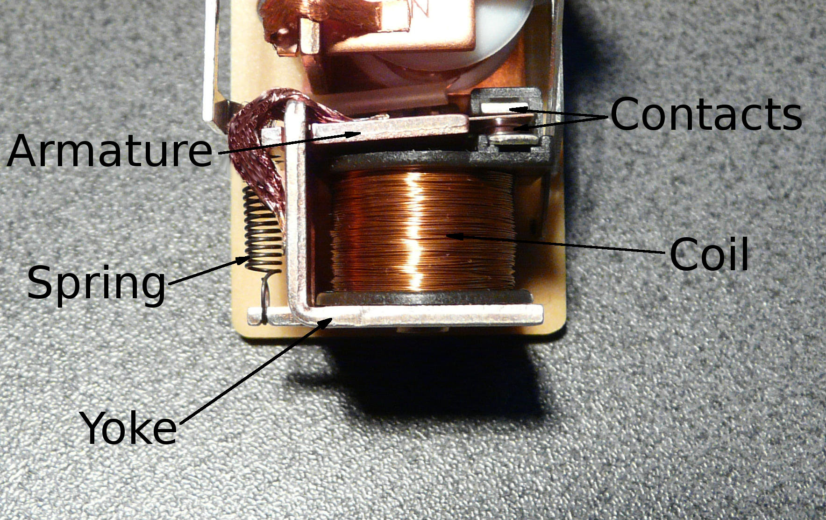
Relay
Relay is a mechanically controlled switch, which uses an electromagnet inside.
When the electric current flows in to the electromagnet, it can switch another circuit on/off or between two circuits in this case.
The left figure is the latter kind
Image: from Wikimedia Commons, https://upload.wikimedia.org/wikipedia/commons/0/05/Relay_Parts.jpg (public domain)

Slide 38
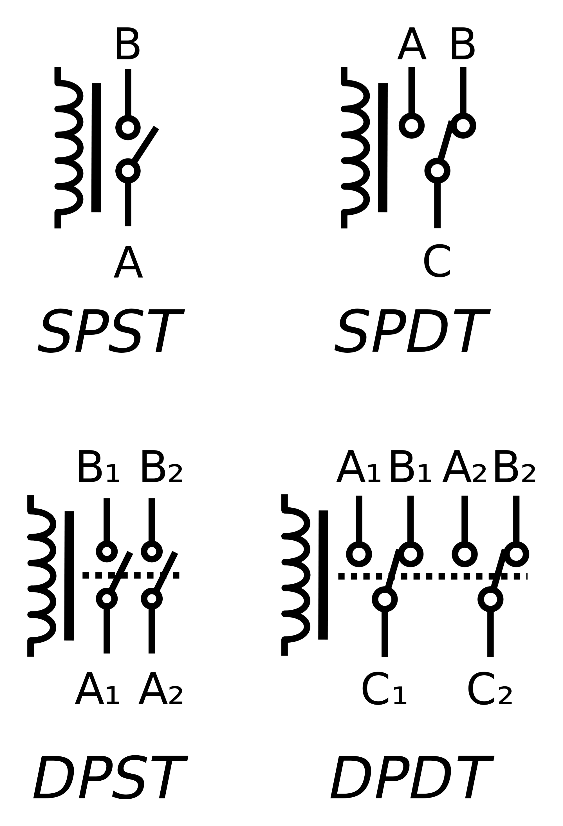
Relay
There exists several kinds of relays.
SPST – Single-Pole Single-Throw
SPDT – Single-Pole Double-Throw
DPST – Double-Pole Single-Throw
DPDT – Double-pole Double-Throw
Image: from Wikimedia Commons, https://commons.wikimedia.org/wiki/File:Relay_symbols.svg (public domain)

Slide 39
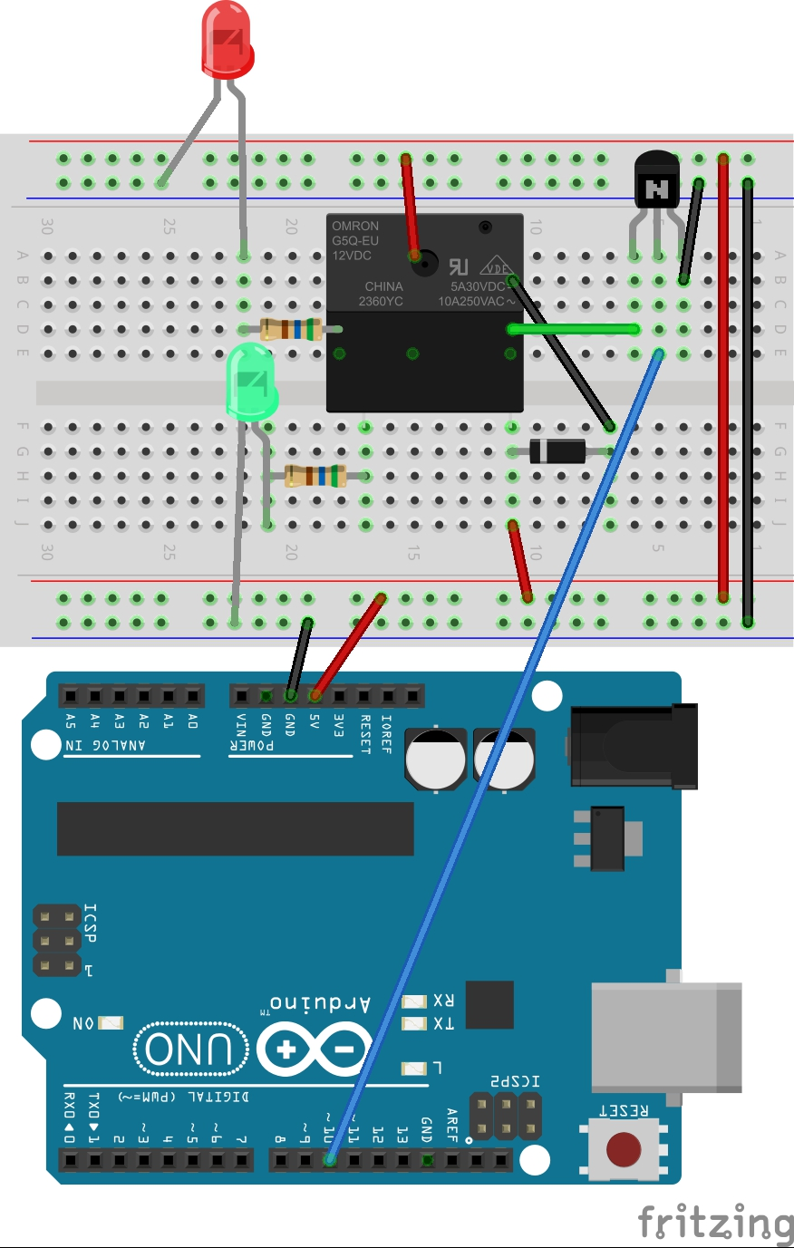
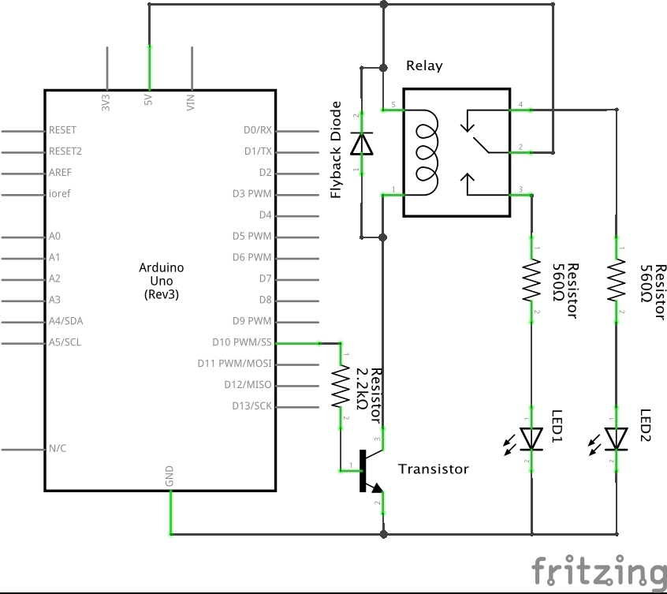
Relay
Here is an example circuit to control a relay

Slide 40
Relay
Explain why we need a diode here.

Slide 41
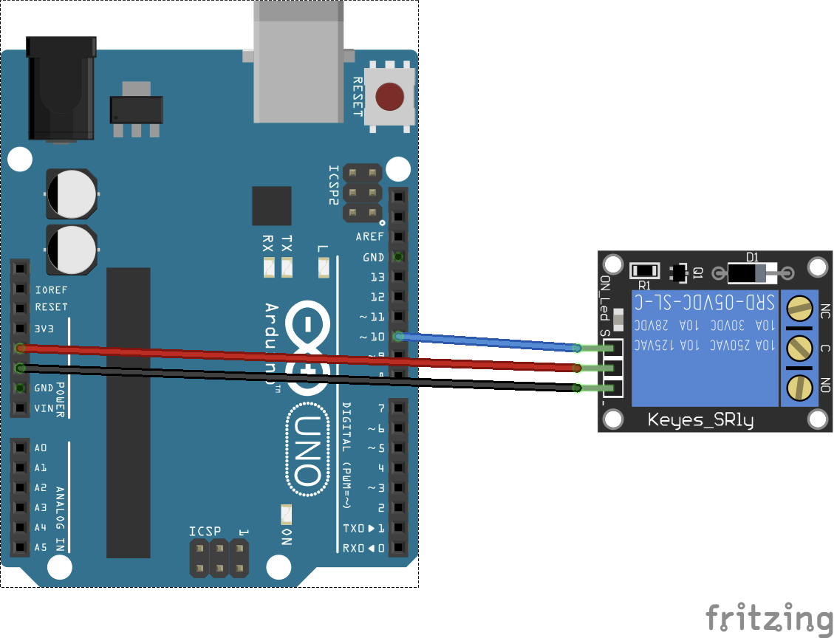
Relay
However, there exist various relay modules, which is quite easy to use.

Slide 42
Ardestan Exercise #2
Create a program and a circuit that control a push-pull solenoid by a button.

Slide 43
Ardestan Exercise #3
Create a program and a circuit that use a relay to switch on/off another circuit with a LED and a resistor by a button.

Slide 44
What We Learned So far
How to use a DC Motor
DC Motor
Transistor
Flyback Diode
Other Electric Parts
Solenoid
Relay
MP3 Player
MINI LCD Display

Slide 45
Session 3.3: MP3 Player and MINI LCD Display

Slide 46
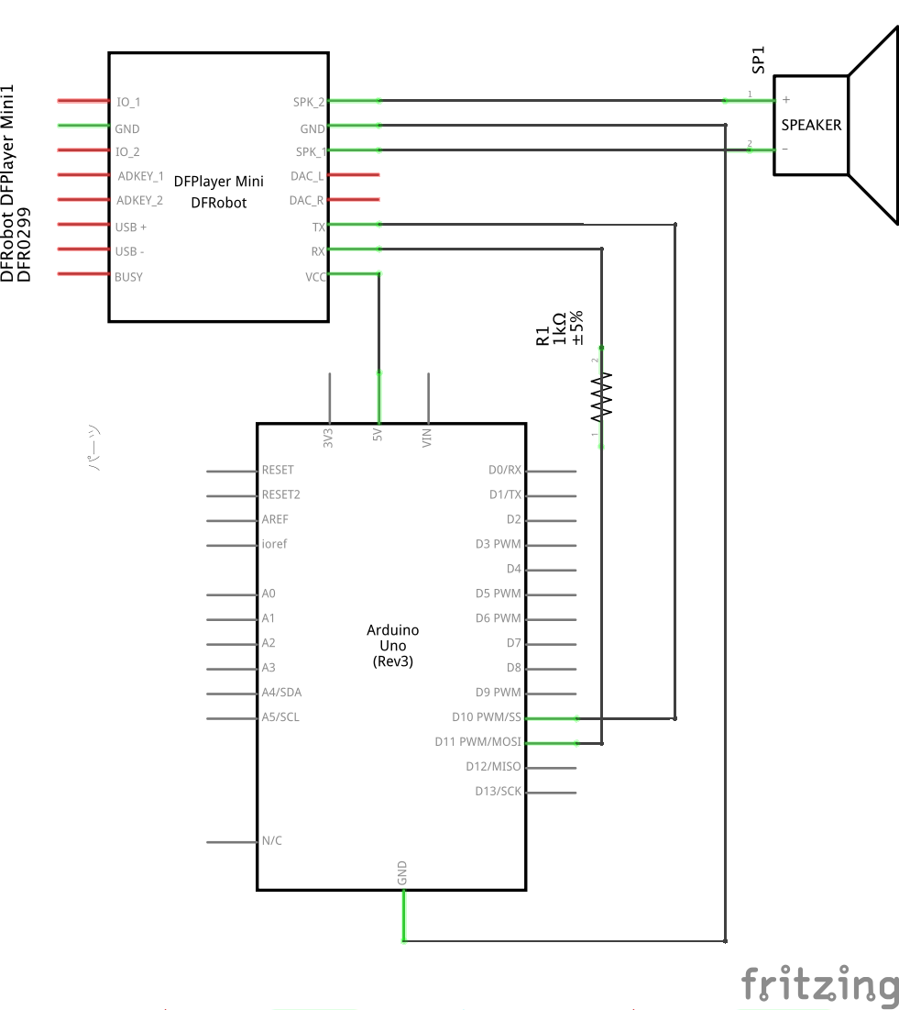
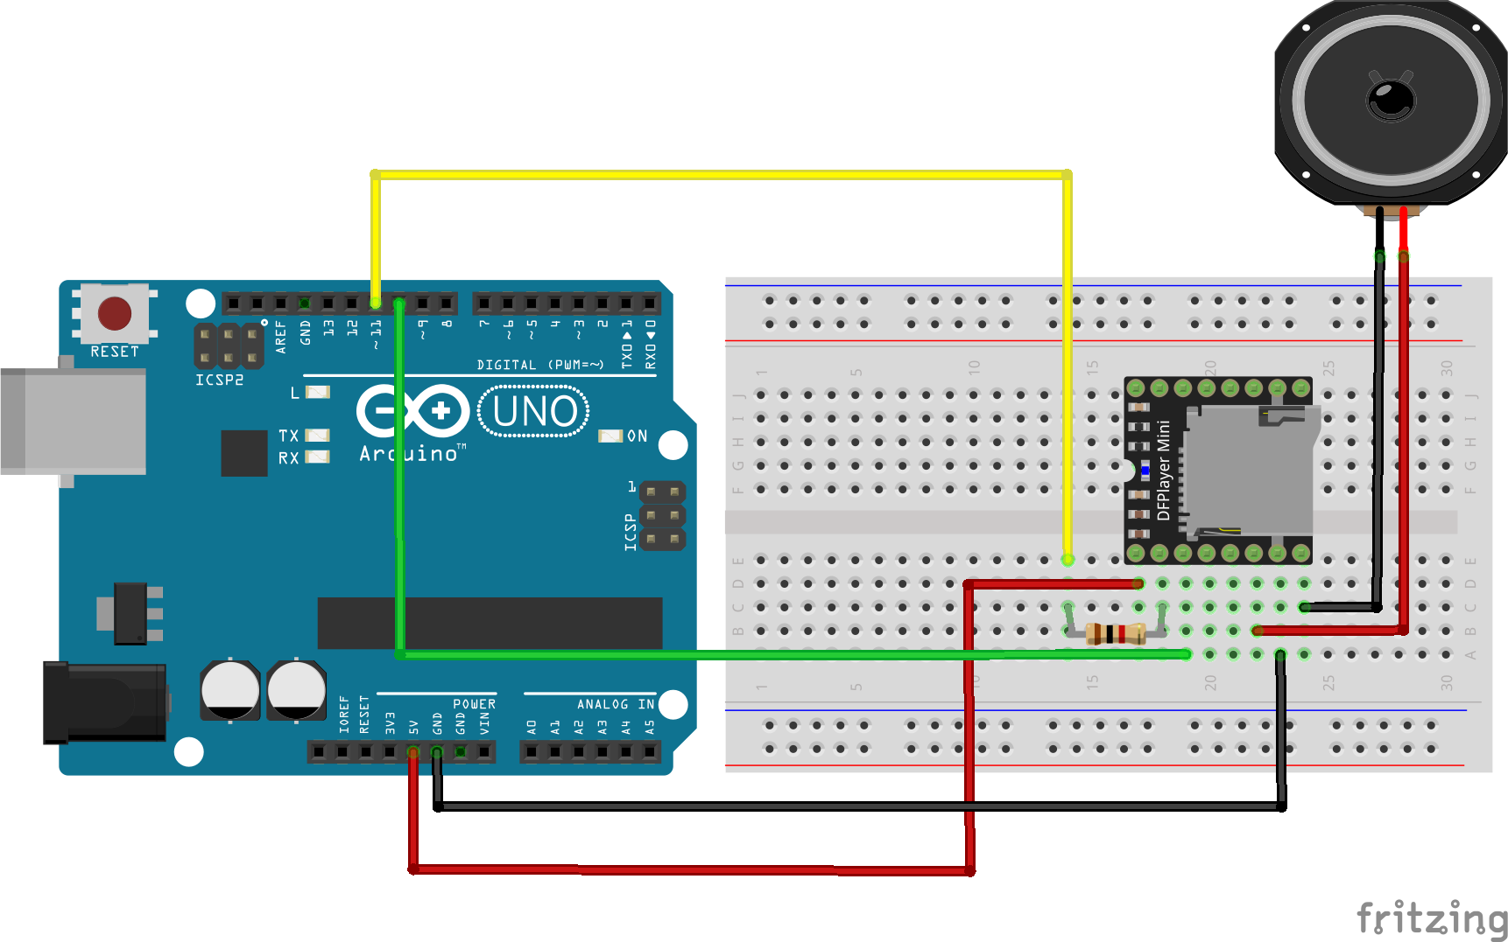
MP3 Player
Create a below circuit
Be sure that the direction of the DFPlayer Mini and the connection are all correct. Otherwise, you can break the DFPlayer Mini.
1kΩ

Slide 47
MP3 Player
Prepare a Micro SD.
Put the MP3 files into the SD card.
Name your files like 00XX_[song title].mp3, For instance,
0001_song_title.mp3 0002_song_title.mp3 0003_song_title.mp3
Creates a folder ‘mp3’ under the root directory of your SD card.
/mp3/0001_song_title.mp3 0002_song_title.mp3 0003_song_title.mp3 DO NOT CREATE ANYTHING ELSE IN THE SD CARD!
Otherwise, it may not work as expected.

Slide 48
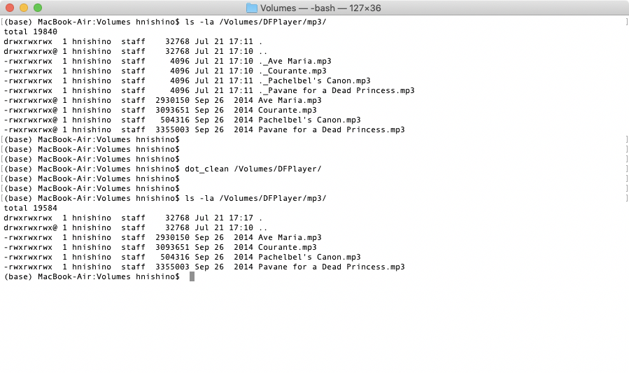
MP3 Player
Mac users should execute “dot_clean /Volumes/<SDVolumeName>” in the Terminal application, to remove unnecessary files in the SD card (always do this!).

Slide 49
MP3 Player
The dfplayer_mini object controls the DFPlayer Mini module.
When it received an integer value at the left inlet, it is used as the song number to play back.
An integer value received at the right inlet specifies the playback volume.
There are also the features such as, pause/start, volume up/down, next/previous. See more details for the help file.

Slide 50
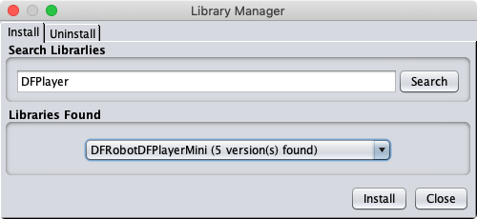
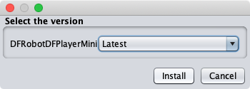
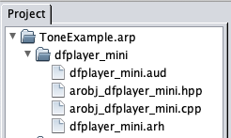
MP3 Player
To use the dfplayer_mini object, install the DFRobotDFPlayerMini library from the Library Manager.
Then, unzip the file dfplayer_mini and place the directory inside your project folder.

Slide 51
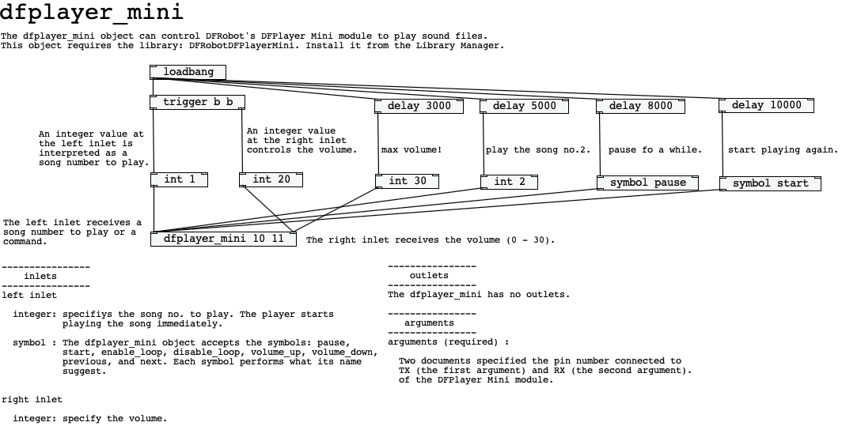

Slide 52
Ardestan Exercise #4
Create a mp3 player with three buttons
start playing when the left button is pressed.
pause when the middle button is pressed.
skip to the next song when the right button is pressed.

Slide 53
Mini LCD Display
Ardestan also provides an object for lcd displays.
Currently only supports an LCD display with the i2c interface (the LCD controller should be HD44780-compatible; most LCD displays uses this).
Image: https://www.sparkfun.com/products/9395 (CC BY 2.0)

Slide 54
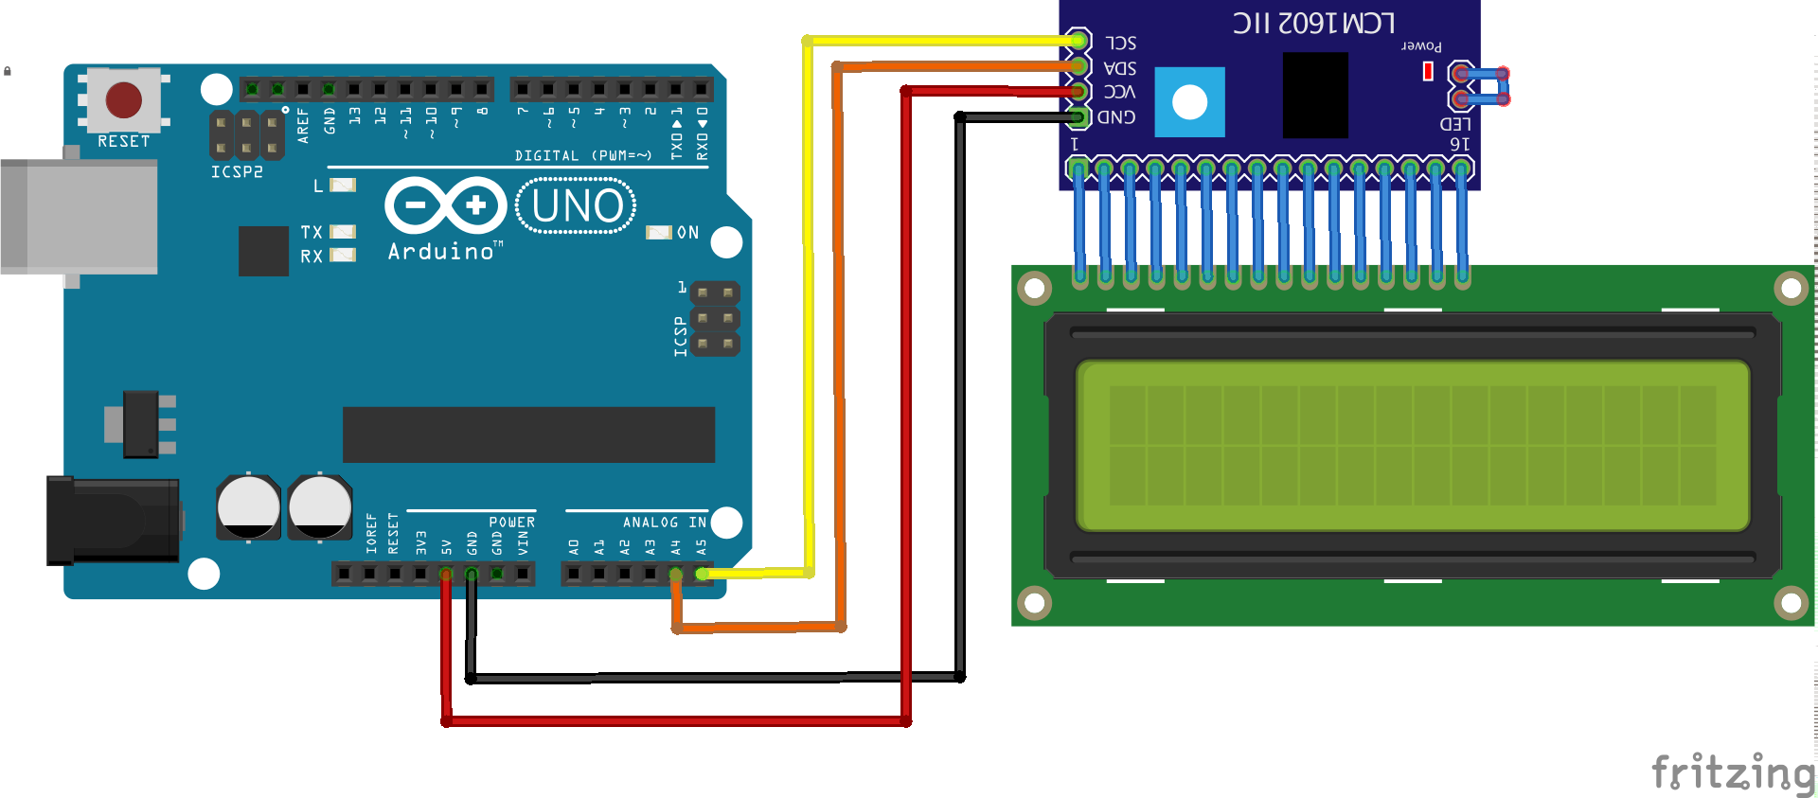
Mini LCD Display
Connect the Mini LCD Player to the Arduino as below

Slide 55
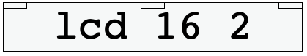
lcd objcet
The lcd object can be used to control a HD44780-compatible i2c LCD display.
The object will display string/integer/float values (that are received at the left-most inlet) at the current cursor position of the LCD display.
See the help file for more details.

Slide 56
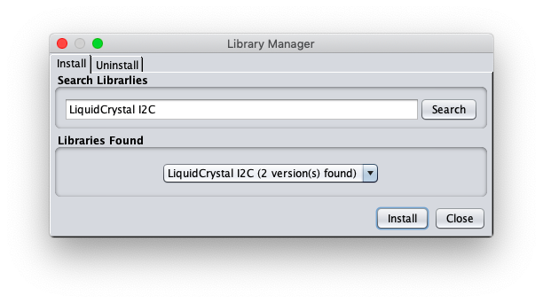
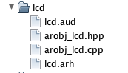
lcd objcet
To use the lcd object, first install the Liquid Crystal I2C library from the Library Manager.
Then, unzip the file: lcd to your project directory.

Slide 57
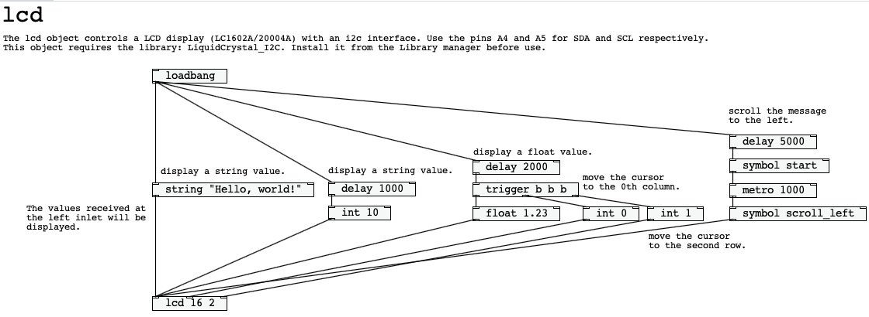
lcd objcet

Slide 58
Ardestan Exercise #5
Create a mp3 player with a mini LCD display.
Display a current song number of the mp3 player in the LCD display (show some message like “Song No: 2”) at the first row of the display.
Let the play back volume be controlled by a potentiometer. Display the current volume at the second row of the display.

Slide 59
What We Learned Today
How to use a DC Motor
DC Motor
Transistor
Flyback Diode
Other Electric Parts
Solenoid
Relay
MP3 Player
MINI LCD Display

